Slide 1
THE MISSION OF OFFICE PROFESSIONALS ACROSS CAMPUS (OPAC) IS TO ENCOURAGE
PROFESSIONAL AND INDIVIDUAL GROWTH BY PROVIDING OPPORTUNITIES FOR
NETWORKING, RECOGNITION,
AND EXCHANGE OF
IDEAS.
LEARN MORE

Slide 2
IT PRODUCTIVITY TOOLS
NATE WALTON & ADAM STOUT
08-28-2026

Slide 3
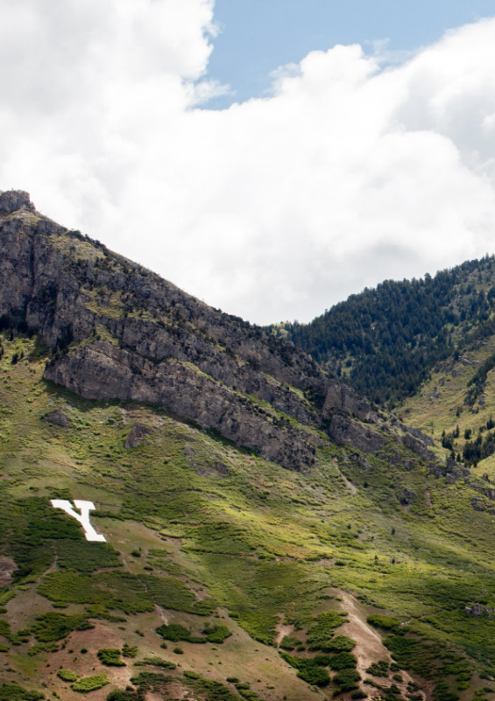
OBJECTIVES
Work more efficiently
Automate routine tasks
Improve processes with existing tools
Apply practical use cases and best practices
Know when to use—or avoid—each tool
Connect tools into effective workflows

Slide 4
SHARED CHALLENGES
Requests & Intake
Approvals & Signatures
Scheduling
Communication Materials
File Sharing & Organization
Manual Processes
Inefficiency

Slide 5

We don’t need more tools—we need clearer ways to use the ones we already have
–––

Slide 6

INTAKE WITHOUT
INBOX CHAOS

Slide 7
Default intake tools
Task and Request Intake
Email (“Just send me a message”)
Teams chat or DMs
Teams channel posts
Shared documents (“Add your name to the list”)
Verbal requests / hallway asks
Notes:
Why these feel convenient
Low setup
Everyone already knows how to use them
Feels flexible
None of these are ‘bad.’ They just don’t age well once volume goes up or more than one person is involved.

Slide 8
When they break down
Task and Request Intake
Missing or incomplete information
Requests may get buried or forgotten
No status tracking
Doesn’t scale or hand off easily
Notes:
information quality breaks down

Slide 9
Recommended tool
Task and Request Intake
Microsoft Forms
Fast setup
Consistent input
Trackable requests
forms.cloud.microsoft

Slide 10
Microsoft Forms
Task and Request Intake
Good fit:
Not a good fit:
You ask for the same information each time a request is made
You want a single place to review requests
Multiple people may need to see or act on the request
One‑off or informal requests
Back‑and‑forth discussions, negotiation, or brainstorming
The overhead of a form would slow things down
Requests that should be tracked in a case management system
Notes:
If you always ask follow‑up questions or want to better track routine task requests, use a Form.

Slide 11
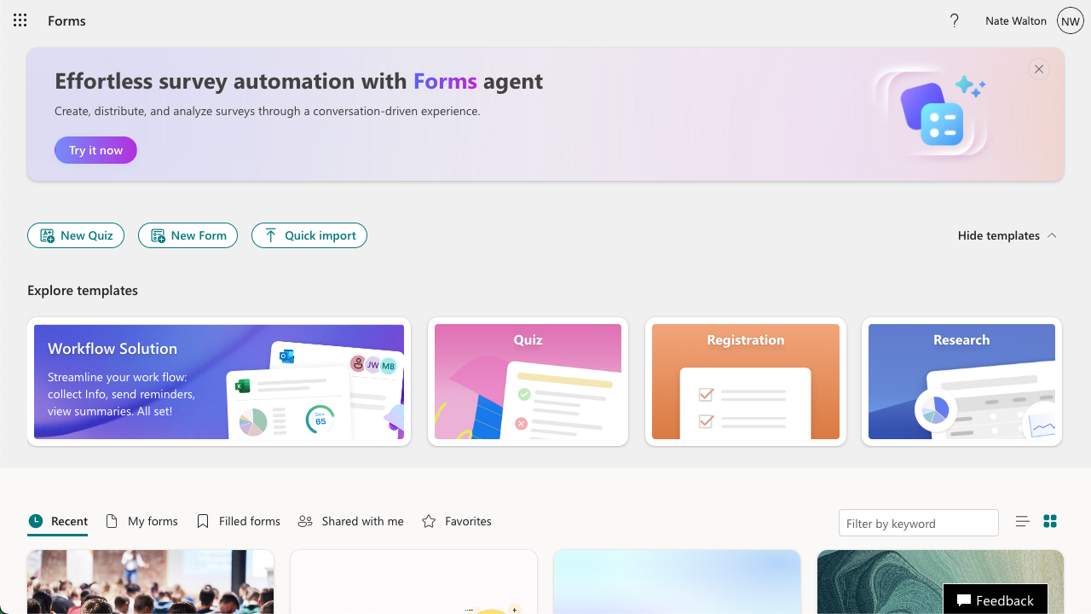
Notes:
“What’s the minimum Form I need to speed things up?”

Slide 12
Microsoft Forms
Surveys and Questionnaires
Use MS Forms wherever possible
Only use Qualtrics for research, and then only for cases where MS Forms will not suffice
Notes:
If you always ask follow‑up questions or want to better track routine task requests, use a Form.

Slide 13
APPROVALS
THAT DON’T STALL

Slide 14
Default tools
Approval Processes
Printed forms
Email “paper trails”
Emailed attachments
Chat-based approvals
Shared documents
In-person conversations

Slide 15
When they break down
Approval Processes
No clear source of truth
Approvals missed or delayed
Hard to prove who approved what, when
Difficult to enforce order (A before B)
Manual reminders fall on one person
Poor experience for approvers
Notes:
Accountability breaks down

Slide 16

Recommended tool
Approval Processes
Adobe Acrobat Sign
Flexible workflows
Secure form completion & signing
Audit trail built in
Group ownership possible
sign.byu.edu

Slide 17
Adobe Acrobat Sign
Approval Processes
Good fit:
Not a good fit:
Formal approvals or signatures
Defined sequence of approvers
Need to prove who approved and when
Recurring or reusable forms
More than one stakeholder involved
Simple acknowledgements
Informal agreement
Variable processes
One‑off decisions
Notes:
If order or proof matters, use Acrobat Sign.

Slide 18
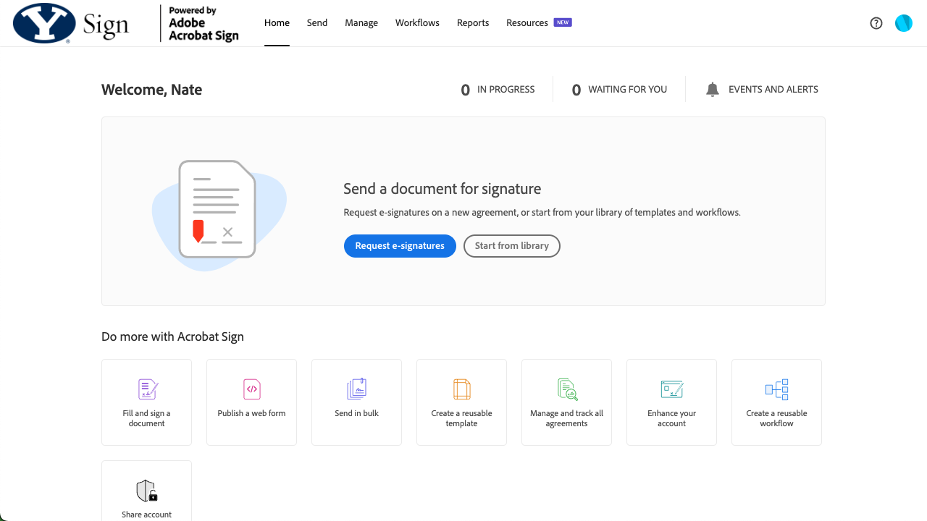

Slide 19
SCHEDULING WITHOUT
BACK-AND-FORTH

Slide 20
Default tools
Scheduling
Outlook calendar
Email or chat conversations
WhenIsGood, Calendly, or similar apps

Slide 21
When they break down
Scheduling
Doesn’t work if both parties aren’t on BYU Outlook
Time‑consuming to check calendars and suggest times
Too much back‑and‑forth for simple meetings
Hard to offer consistent availability
Notes:
Time and consistency break down

Slide 22
Recommended tool
Scheduling
Microsoft Bookings
Share availability without emails
Let others book during set times
Works with internal and external guests
Automatically updates your calendar
bookings.cloud.microsoft

Slide 23
Microsoft Bookings
Scheduling
Good fit:
Not a good fit:
One‑on‑one meetings
Office hours or advising
Consultations or check‑ins
Group scheduling
Scheduling with any available person in a group
Many-to-one scheduling (one meeting where many people can book spots)
Situations where flexibility matters more than speed and consistency
Peer group coordination
Notes:
“If you find yourself typing ‘Here are three times that might work…’, Bookings may be the fix.”
If you’re offering the same availability repeatedly, use Bookings.

Slide 24
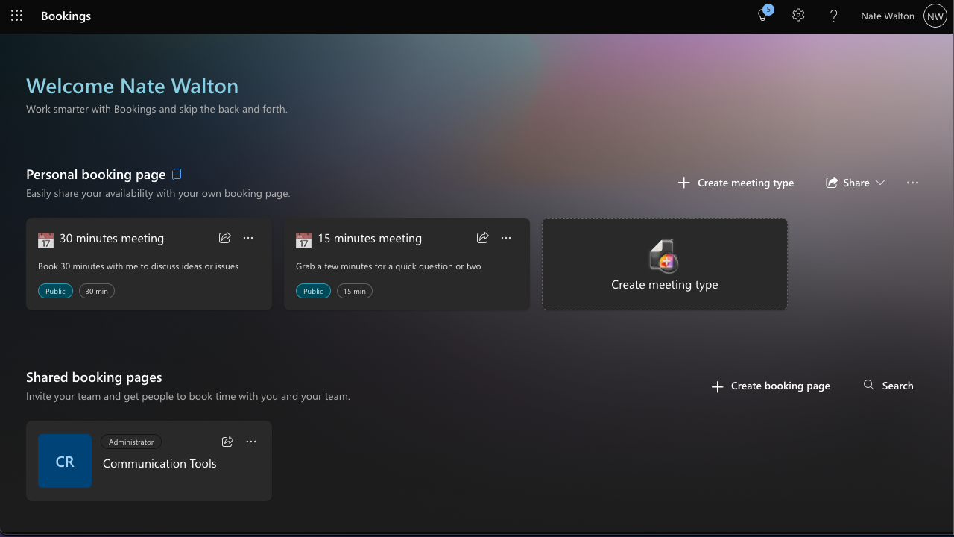

Slide 25
CREATE PROFESSIONAL COMMUNICATIONS

Slide 26
Default tools
Communication Artifacts
Word
PowerPoint
Google Docs
Canva

Slide 27
When they break down
Communication Artifacts
Not visually polished
Crazy MS Word reflows
Costs
Personal accounts
No QR code capabilities
Notes:
Time and consistency break down

Slide 28
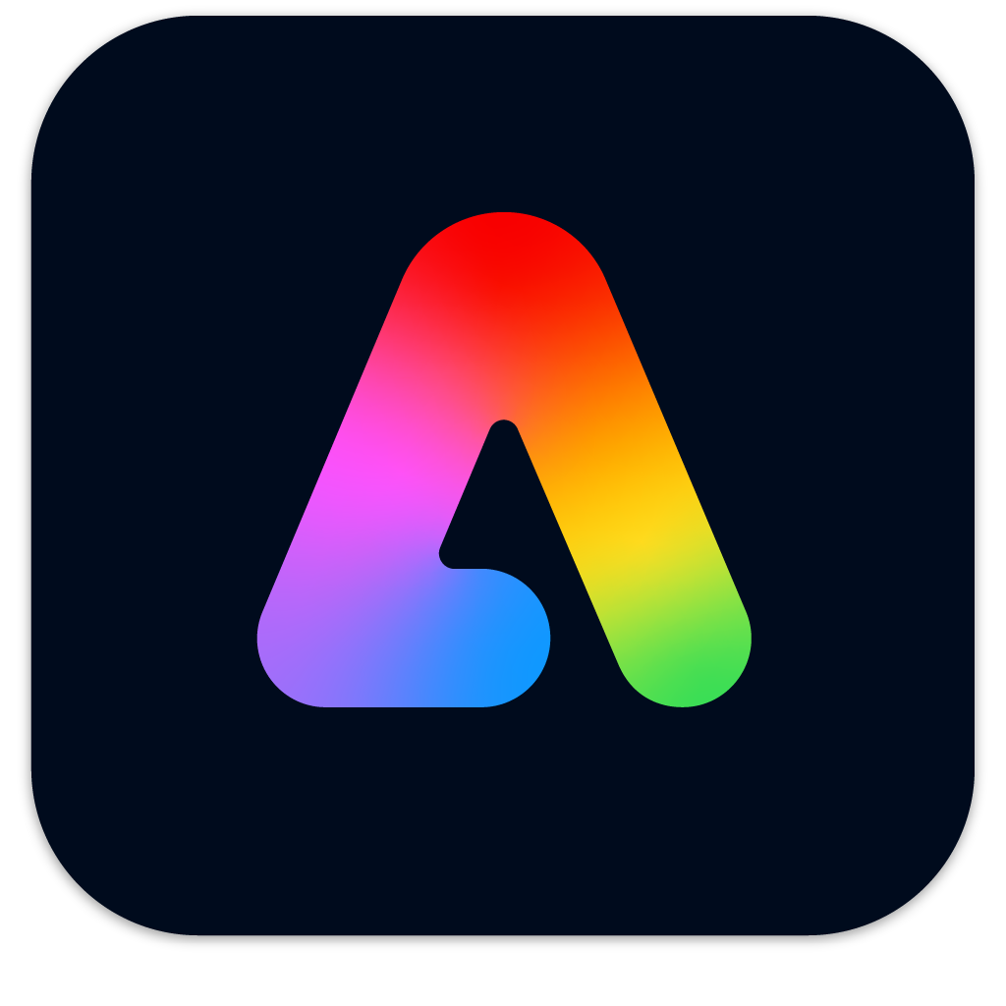
Recommended tool
Communication Artifacts
Adobe Express
Use in any browser
Templates for many digital and printed applications
Includes design elements and fonts
Easy drag-and-drop interface
express.adobe.com

Slide 29
Adobe Express
Communication Artifacts
Good fit:
Not a good fit:
Social posts
Flyers and signage
Presentations
QR codes
Short videos
File conversions and resizing
Multiple variants for different platforms
Press-ready print
Full-size or full-length video
Complex layered design (no masks, blends, or vectors)
Long documents
Notes:
“If you find yourself typing ‘Here are three times that might work…’, Bookings may be the fix.”
If you’re offering the same availability repeatedly, use Bookings.

Slide 30
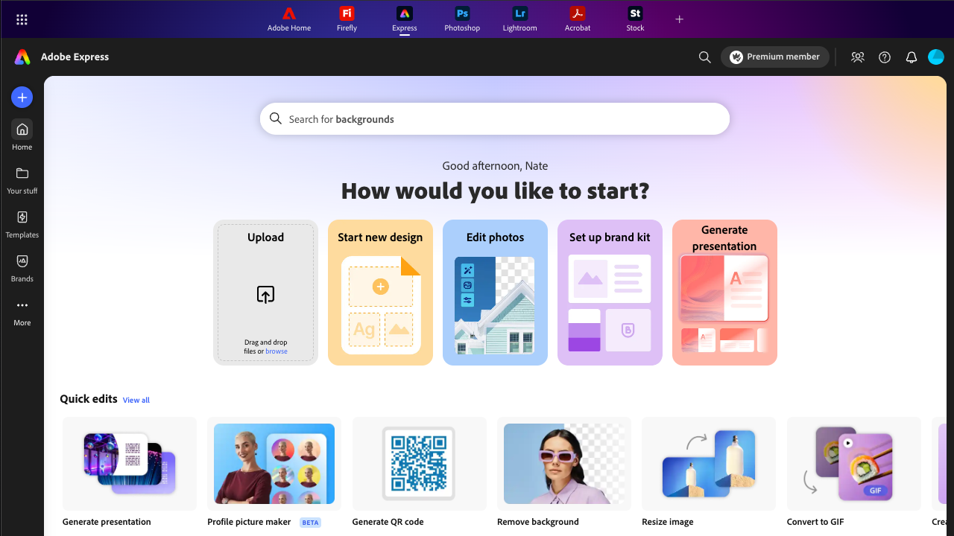

Slide 31
More Tools
Communication Artifacts
Photo.byu.edu
Adobe Creative Cloud (paid)
  Adobe Creative Suite applications
  Adobe Fonts
  Adobe Stock

Slide 32
FILE HOSTING
AND SHARING

Slide 33
Tools Commonly In Use
File Hosting and File Sharing
Shared Box folders
Email attachments
Teams chat uploads
OneDrive folders
OneNote notebooks
Google Drive
Dropbox
Department SaaS systems
File Server, NAS, etc.

Slide 34
When they break down
File Hosting and File Sharing
Difficult to remember which platform things are stored on
Using personal accounts instead of institutional identity
Roles, assignments, and access can be difficult
Poor provisioning and deprovisioning
Someone leaves and takes the admin access with them
What is OIT's recommendation?

Slide 35
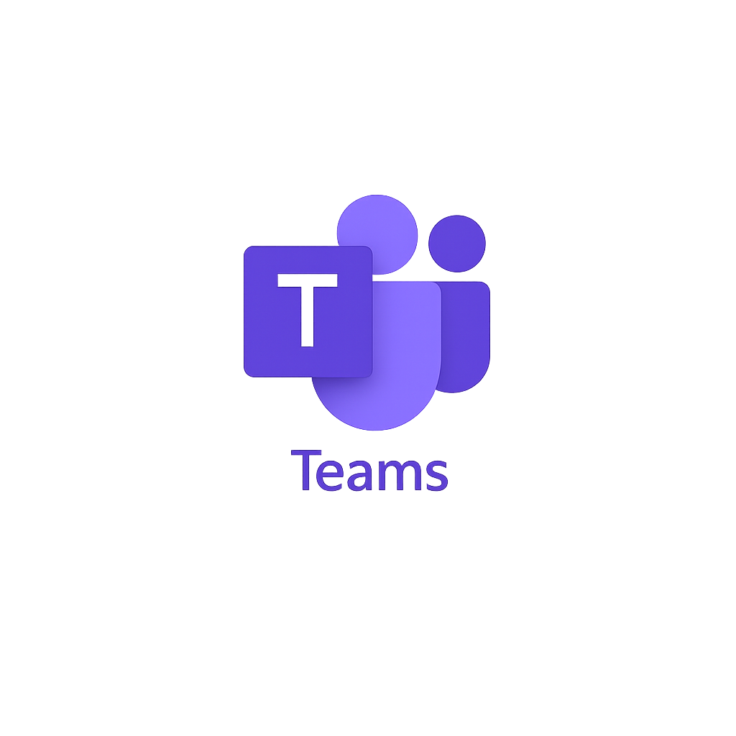
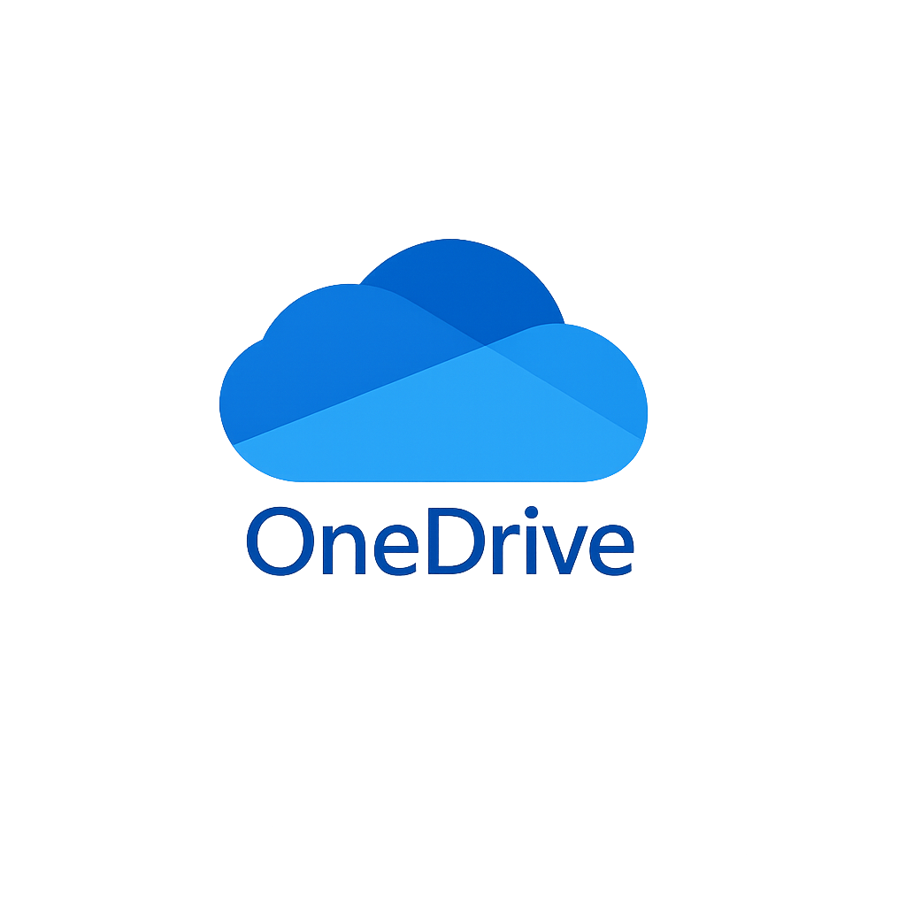

Recommended tools
File Hosting and File Sharing
OneDrive – Individual work files (not personal files)
Teams – Collaborative files
Box – Broad access, hosting, or external access
Notes:
This is as much a philosophy of organizational management as it is best practices for these tools
Philosophy = personal use, team use, broad use (department, BYU campus, public)
Good examples
Departments with very specific folder structure based on roles, access, business rules.

Slide 36
OneDrive
My Work
Good fit:
Not a good fit:
Work drafts / work-in-progress
Individual notes, research, prep
Not ready for sharing...yet
Temporary staging before Teams/Box
Shared or department content
Short or long-term access for others
Course materials
Institutional/standard documents

Slide 37
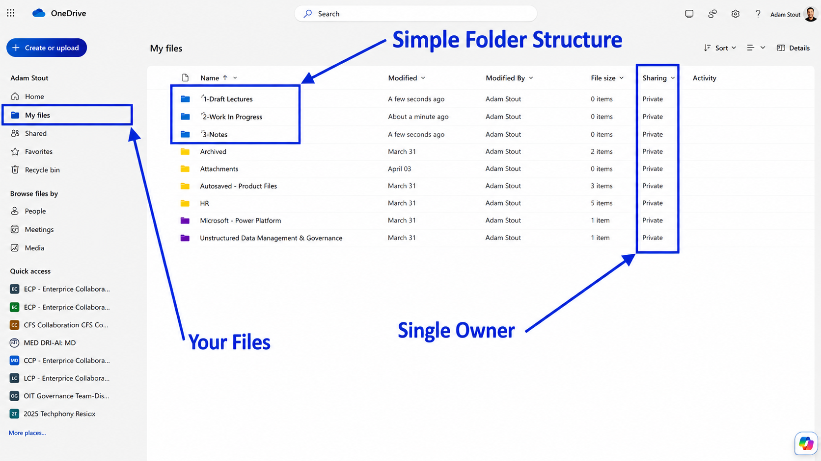

Slide 38
Microsoft Teams
Our Work
Good fit:
Not a good fit:
Team/department collaboration
Course files (faculty + students)
Active, frequently edited documents
Shared ownership (no single admin)
Replaces: email attachments, shared drives, Google Drive/Dropbox, department file servers
Personal-only files
Finalized or rarely changed content
Long-term storage / hosting
Highly structured repositories

Slide 39
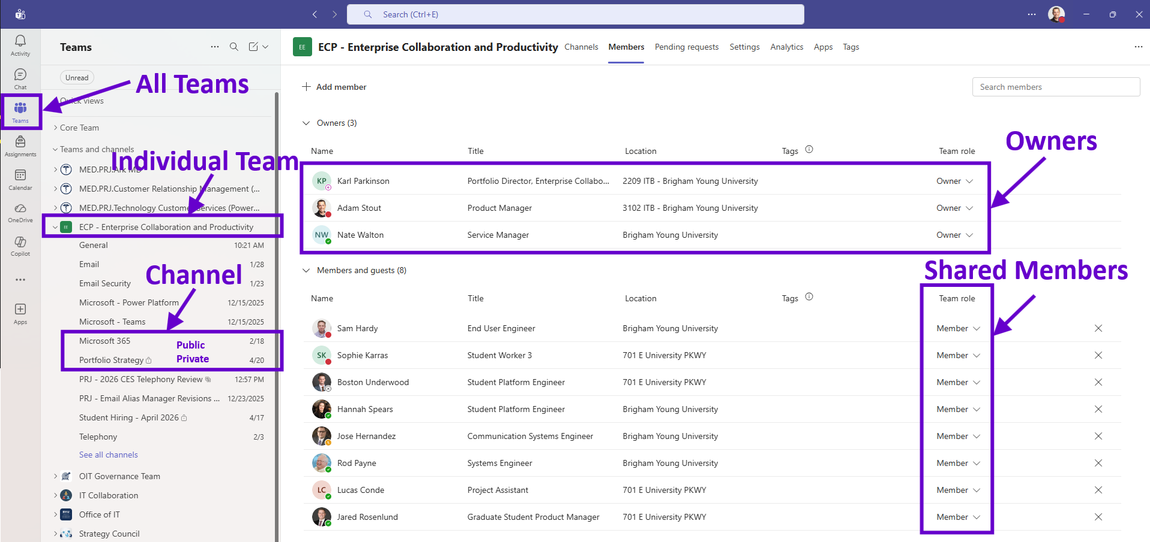
Notes:
Teams is approved by the University, supported by staff and funding, and the preferred collaboration tool for files and chat
You as faculty or staff can manage ownership and membership at an administrative level, not a single owner.
This helps with transitions, onboarding, offboarding, and appropriate access.

Slide 40
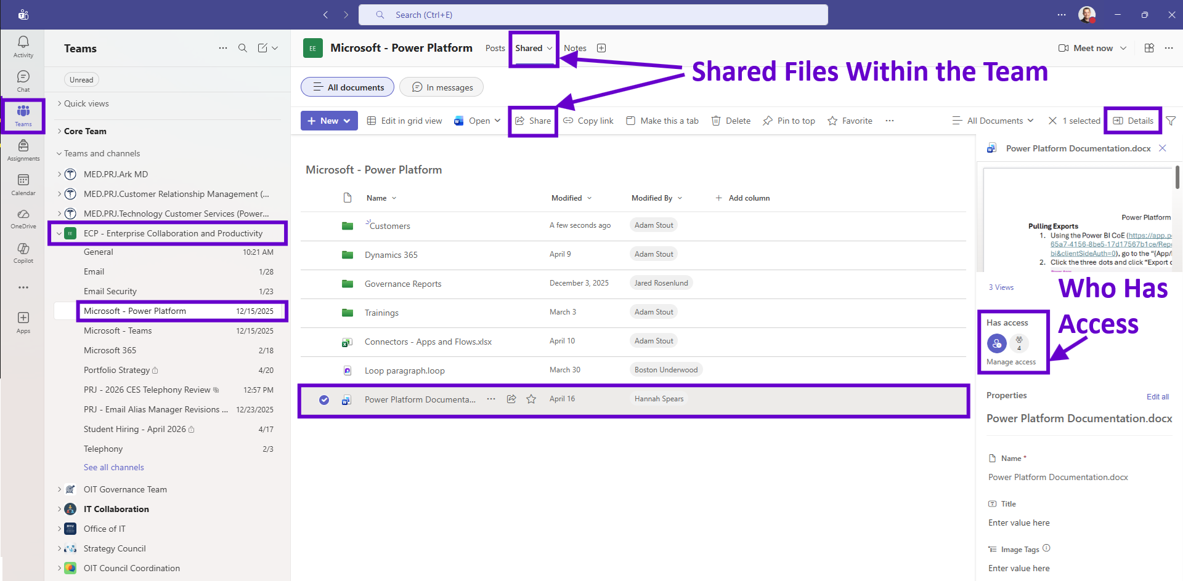
Notes:
Files live inside the Teams / channel
Not tied to an individual
Used as primary collaboration workspace
There are Owners, Members, and Visitors
Permission are group based
File sharing is done with context (channel purpose / objective)

Slide 41
Box
Institutional Work
Good fit:
Not a good fit:
Finalized, reference content
Department or institutional files
Longer term hosting for solid references
Structured, organized repositories
Managed by CSRs or Department
Active collaboration
Frequent edits
Single file ownership where no one needs access

Slide 42
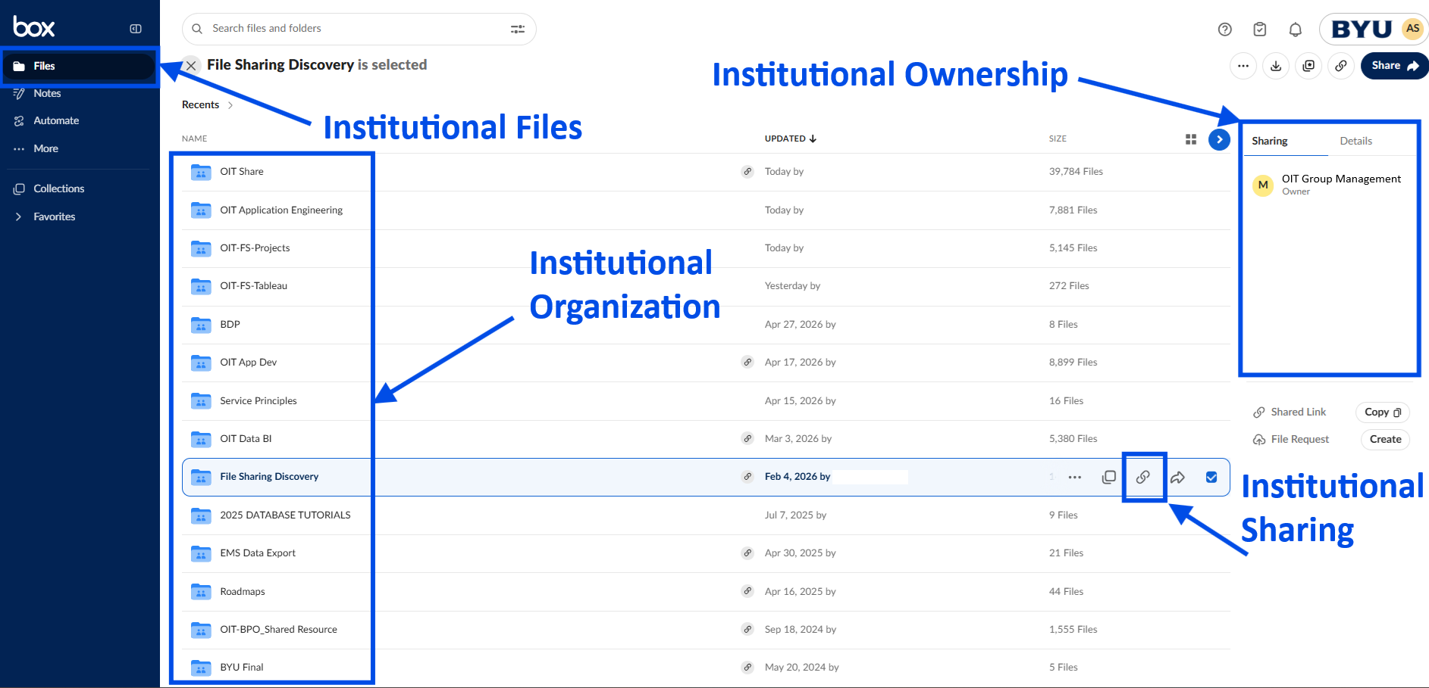
Notes:
Organization-Owned content
Best for finalized or reference materials
Structured, consistent folder hierarchy (Let CSR's maintain)
Controlled sharing and access
Long-term availability independent of individuals or teams

Slide 43
File Hosting & Sharing Best Practices
Concept | OneDrive | Teams | Box
Ownership | Individual | Group (Team) | Organization / Department
Use case | Drafts, personal work | Active collaboration | Finalized / reference content
Structure | Personal folders | Teams & channels | Standardized folders
Sharing | Ad hoc | Membership-based | Controlled / permission-driven
Risk | Leaves with user | Persists with team | Persistent institutional hosting
Change level | As needed | High (collaborative edits) | Low (stable content)

Slide 44
MANUAL PROCESSES

Slide 45
Default Tools
Systems examples with process automation
  Workday
  ServiceNow
  Salesforce (SRM, Success Hub, Admissions)
  Email + Attachments (Unofficial Default)
Notes:
These are large systems with internally built and designed automations.
Most automations exist in enterprise systems, not everyday work.
Workday --> HR, Finance, approvals, payroll, procurement
ServiceNow --> IT and service requests, ticketing workflows
Salesforce (SRM, Success Hub, Admissions) --> Student lifecycle, outreach, case management
Email + Attachments (unofficial default) --> Request, approvals, coordination

Slide 46
When they break down
Where These Tools Do Not Meet Everyday Needs
Processes are too small or informal to justify larger systems
Requests still come through email instead of structured intake
Approvals happen in email chains instead of tracked workflows
Data gets copied manually between systems
Faculty/staff create workarounds (spreadsheets, email tracking)
Hard to connect tools together across workflows
Notes:
Everyday work falls between systems—and becomes manual.

Slide 47

Recommended tools
Power Automate (Personal Productivity)
Microsoft Power Automate
Automates repeatable, rule-based tasks
20+ connections available by default
Connects tools like:
  Forms
  Bookings
  Email
  Teams
  OneDrive
  Box
make.powerapps.com
Notes:
Power Automate fills the gap between systems and daily work.

Slide 48
Power Automate
Filling the Gaps Between Systems & Daily Work
Good fit:
Not a good fit:
The process happens often
The steps are predictable and repeatable
You are currently doing it manually
It involves notifications, simple approvals, small data movement
It improves your personal or team productivity
The process requires complex business logic
Institutional approvals or compliances is needed
The process is one-time or rare
Involves high-risk or sensitive data
There is already a system designed for it
Notes:
Don’t replace enterprise systems—connect and enhance them.
Enterprise systems automate the big processes.
Power Automate helps you automate everything in between.

Slide 49
Example
Personal Productivity (Default Environment)
Student request submitted → Advisor notified + task created
Course evaluation submitted → Results logged + faculty notified
New hire form submitted → Onboarding checklist created + manager notified
Expense receipt uploaded → Approval request sent automatically
Meeting scheduled in Bookings → Teams meeting created + reminder sent
File uploaded to shared folder → Team notified in Teams channel
Class roster updated → Welcome email sent to students
Deadline approaching → Reminder notification sent to faculty/staff
Research data file added → Logged in Excel + team notified
Approval completed → Next approver notified + status updated
Notes:
Power Automate is not a new system—it is the glue that connects tools you already use.

Slide 50
INEFFICIENCY

Slide 51

Microsoft Copilot Chat
Work Smarter, Not Harder with AI Assistance
Research public information and brainstorm ideas
Draft, rewrite, translate, and improve communications
Summarize and analyze uploaded files
Turn notes into outlines, agendas, and checklists
Create announcements, newsletters, and FAQs
Extract decisions, action items, and next steps from notes
Explain procedures step by step from public sources
Build reusable agents with instructions and public sources
copilot.microsoft.com
Notes:
Power Automate fills the gap between systems and daily work.

Slide 52
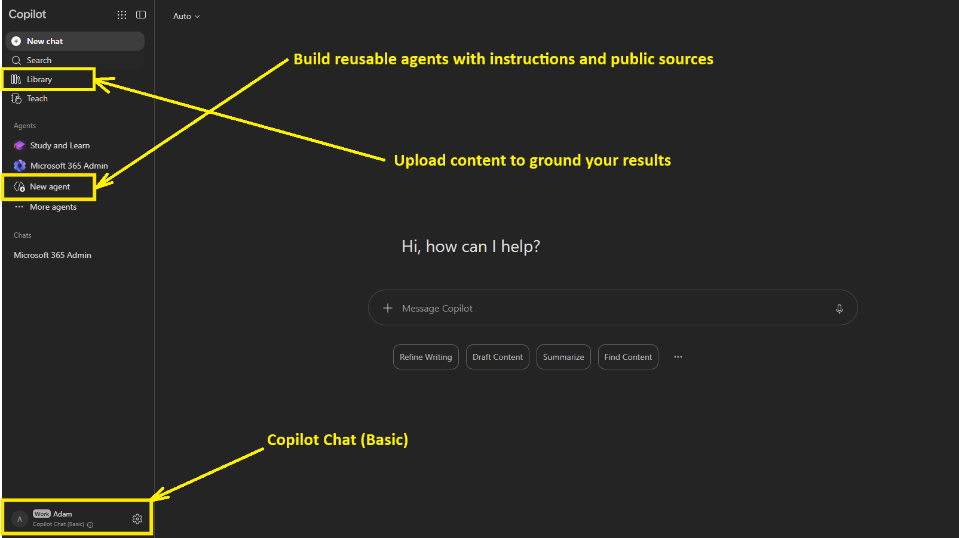
Notes:
Organization-Owned content
Best for finalized or reference materials
Structured, consistent folder hierarchy (Let CSR's maintain)
Controlled sharing and access
Long-term availability independent of individuals or teams

Slide 53
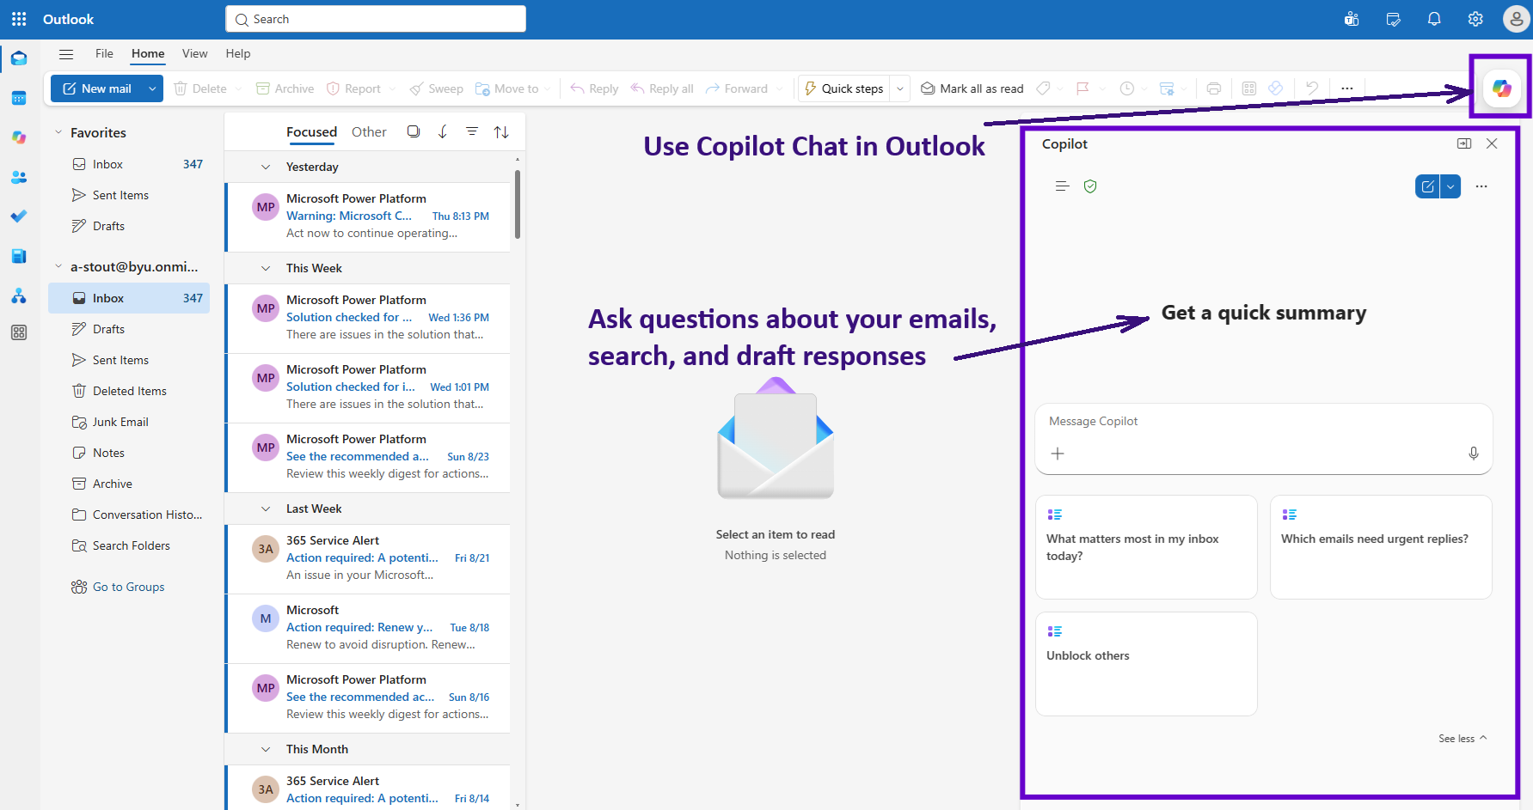
Notes:
Organization-Owned content
Best for finalized or reference materials
Structured, consistent folder hierarchy (Let CSR's maintain)
Controlled sharing and access
Long-term availability independent of individuals or teams

Slide 54
