Slide 1
THE MISSION OF OFFICE PROFESSIONALS ACROSS CAMPUS (OPAC) IS TO ENCOURAGE
PROFESSIONAL AND INDIVIDUAL GROWTH BY PROVIDING OPPORTUNITIES FOR
NETWORKING, RECOGNITION,
AND EXCHANGE OF
IDEAS.
LEARN MORE
Notes:
We’d like to thank OPAC for helping us get the word out about this session. If would like to join OPAC or more information, feel free to scan the QR code. And again, we thank them for their partnership.

Slide 2

DATA, REPORTING, & ANALYTICS
UNIVERSITY CONFERENCE | 28 AUGUST 2026

Slide 3



WELCOME
THANK YOU

Slide 4

COMMON QUESTIONS...
What data is available?
Is it secure?
Where can I find it?
How can I use it?

Slide 5

AVAILABLE RESOURCES
Assessment & Planning
Enrollment Services – Research & Reporting
Enterprise Data Management - OIT

Slide 6
ASSESSMENT & PLANNING
Zack Barrus

Slide 7
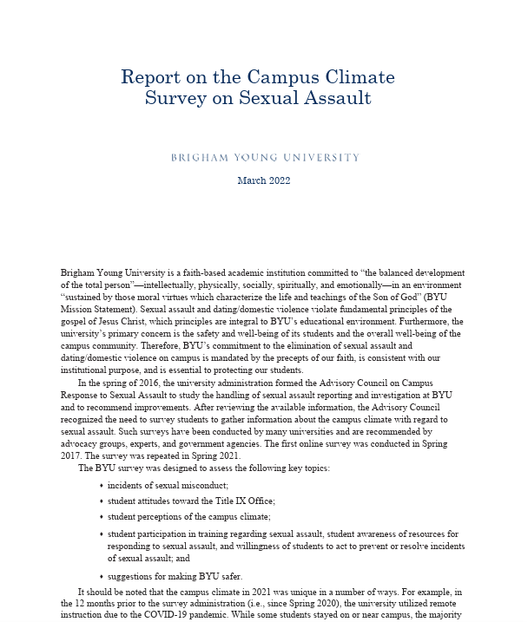
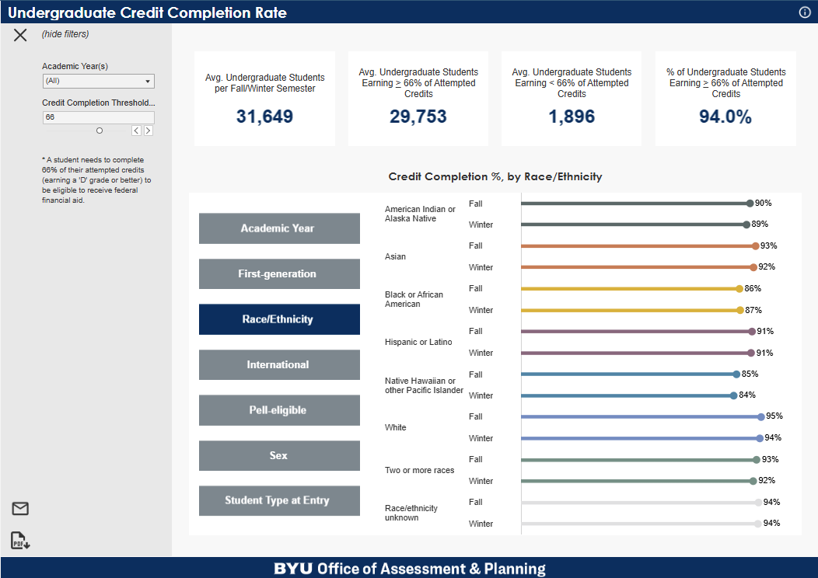

ASSESSMENT & PLANNING
"To assist the university in making data-informed decisions to fulfill the BYU mission and aims..."
We provide quantitative and qualitative analyses ranging from program-level to university-level
Access to analyses dependent upon individuals' roles as chairs, deans, executive leadership, etc.
Primary data sources
        Campus databases (AIM, Workday, etc.)
        Student surveys (graduation exit, recent graduates, alumni, NSSE, non-returning, withdrawal)
        Student interviews/focus groups
Notes:
Assessment and Planning provides institutional research that is of strategic importance to the university.
Two main parts to the mission statement:
Data-informed: We perform both quantitative and qualitative analyses. Quantitative analysis run the gamut from simple summary statistics and business intelligence to econometric modeling. Examples of some of our products are shown here and represent all types of research.
Decisions: We provide data to decision-makers. And as part of effective data governance, we provide access to our analyses based on those decision-makers' roles on campus. When our analyses go down to the department- or program-level we'll provide data to leaders having stewardship over those programs and departments (i.e., department chairs). And when our analyses aggregate metrics at the college-level, we'll provide the analyses to deans and associate deans rather than department chairs.

Slide 8
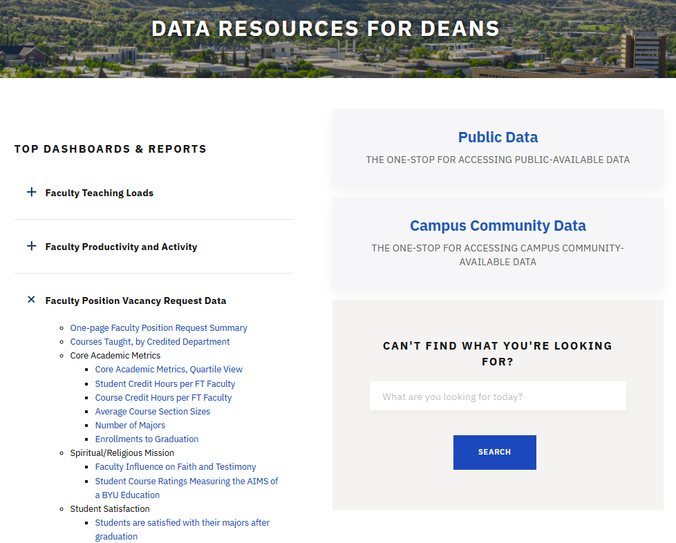
data.byu.edu
The one-stop for accessing university data
Products include dashboards, reports, infographics, etc.
Curated design based on users' roles
Changes coming soon to facilitate search & navigation
Notes:
There are multiple versions of the website, and users are granted access based on their roles. So don't be alarmed if you log in and see something different from what is displayed here.

Slide 9
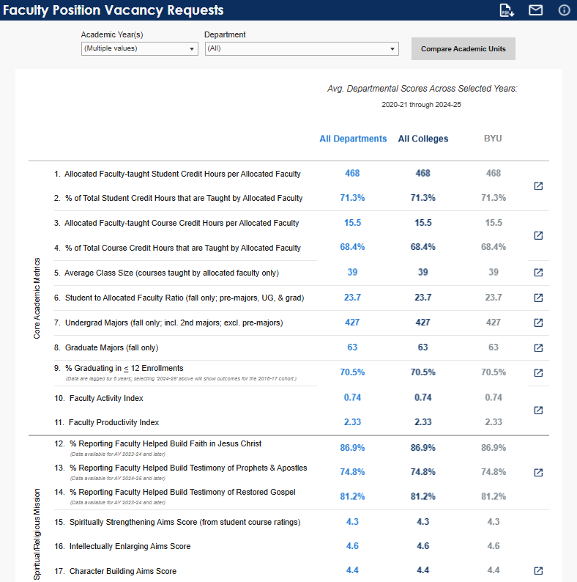
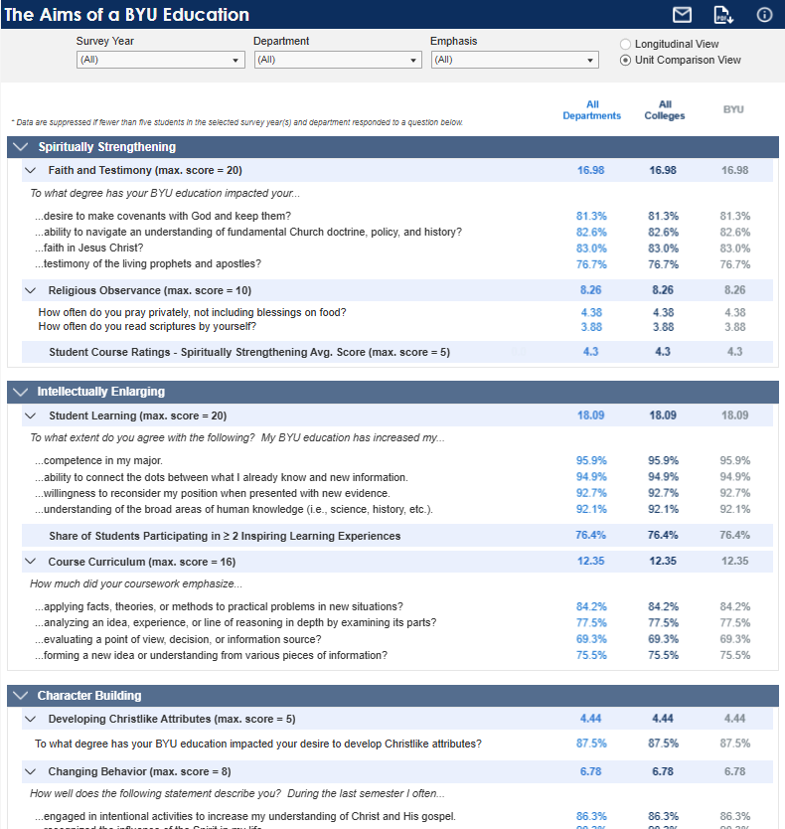
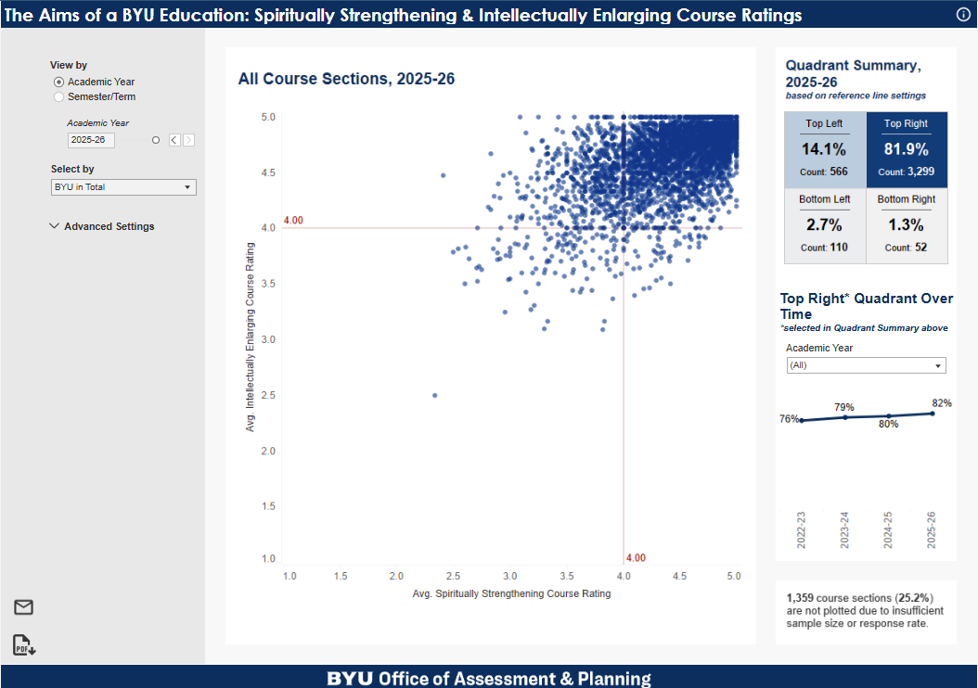
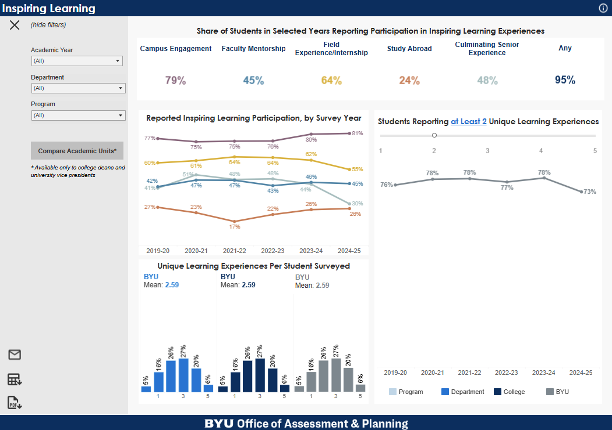
data.byu.edu
The one-stop for accessing university data
Dashboards
        Row-level security
        Often compare departmental, college, and university averages
        Access permissions
Data delegates
        College- and department-level
        Dean/chair must request delegates' access by emailing aimaccess@byu.edu

Slide 10
ENROLLMENT SERVICES – RESEARCH & REPORTING
Meysa Weber

Slide 11
ENROLLMENT SERVICES
Inspired by the Savior’s focus on the one, Enrollment Services facilitates access to the BYU community and promotes student success in ways that are high impact, interconnected, and hidden in plain sight.
Enrollment
Services
Division
Financial Aid & Scholarships
Enrollment Services Office
Admissions
Registrar's
Office
Marketing & Communications
Research & Reporting
Research & Reporting provides the campus community with accurate and actionable data and analytics in the form of Excel files and Tableau dashboards.
Notes:
We provide the campus community with student academic data reports in the form of excel files and Tableau dashboards.

Slide 12
ENROLLMENT SERVICES
Inspired by the Savior’s focus on the one, Enrollment Services facilitates access to the BYU community and promotes student success in ways that are high impact, interconnected, and hidden in plain sight.
Research & Reporting provides the campus community with accurate and actionable data and analytics in the form of Excel files and Tableau dashboards.
Enrollment
Services
Division
Financial Aid & Scholarships
Enrollment Services Office
Admissions
Registrar's
Office
Marketing & Communications
Research & Reporting
Notes:
We provide the campus community with student academic data reports in the form of excel files and Tableau dashboards.

Slide 13
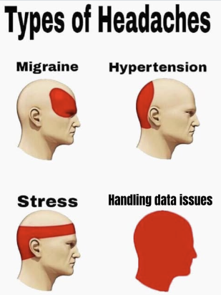
Academic Reporting
Notes:
Start with who this pertains to. Many people can have access to reports, but the most common people are____.
Highlight the difference between getting reports from us and getting a data connection/BDP from OIT (Brad and Markus).

Slide 14
Academic Reporting
Ready-to-use reports
Is not a data connection
Student academic data
Notes:
Start with who this pertains to. Many people can have access to reports, but the most common people are____.
Highlight the difference between getting reports from us and getting a data connection/BDP from OIT (Brad and Markus).

Slide 15
Academic Reporting
academicreporting.byu.edu
Click "New Portal"
Features of the New Portal:
Common Reports for Academic Units:
Custom to your access
“Favorite” reports
Centralized data requests
Search functions
Notes:
Start with who this pertains to. Many people can have access to reports, but the most common people are____.
Highlight the difference between getting reports from us and getting a data connection/BDP from OIT (Brad and Markus).

Slide 16
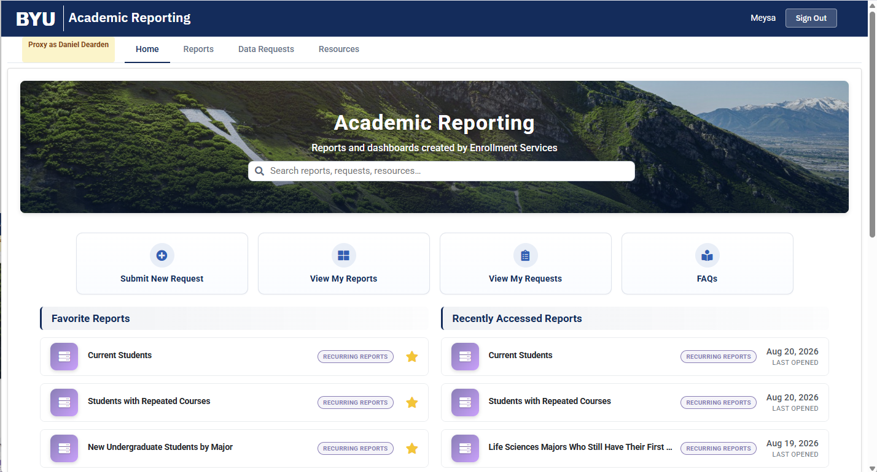
academicreporting.byu.edu
Notes:
This is the landing page and I'm going to walk you through the tabs.

Slide 17
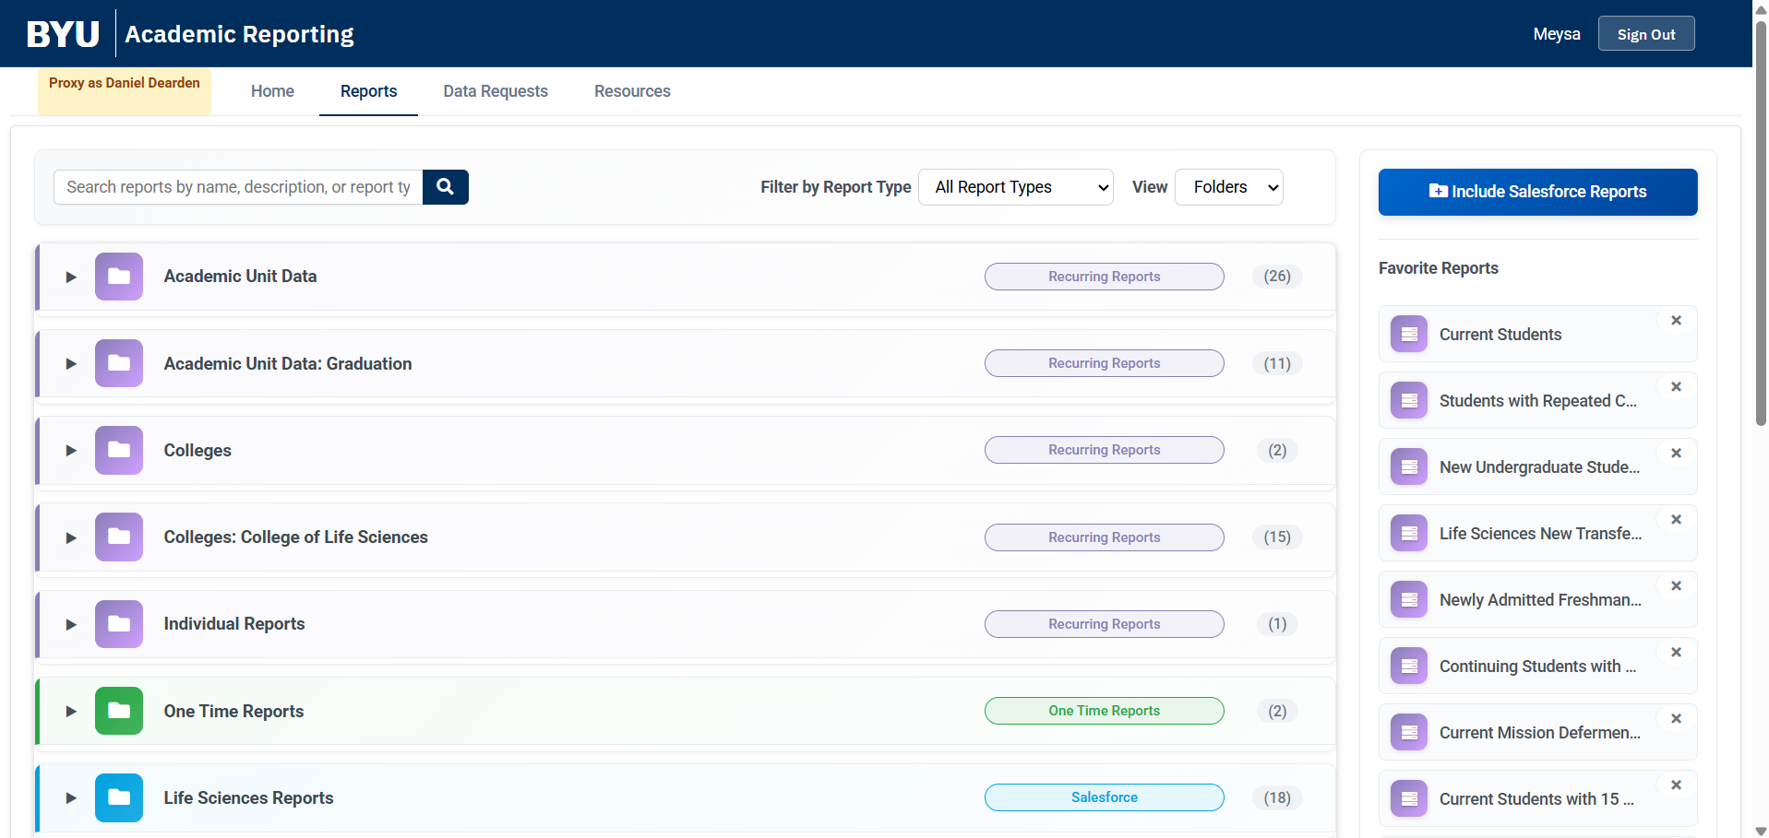
academicreporting.byu.edu

Slide 18
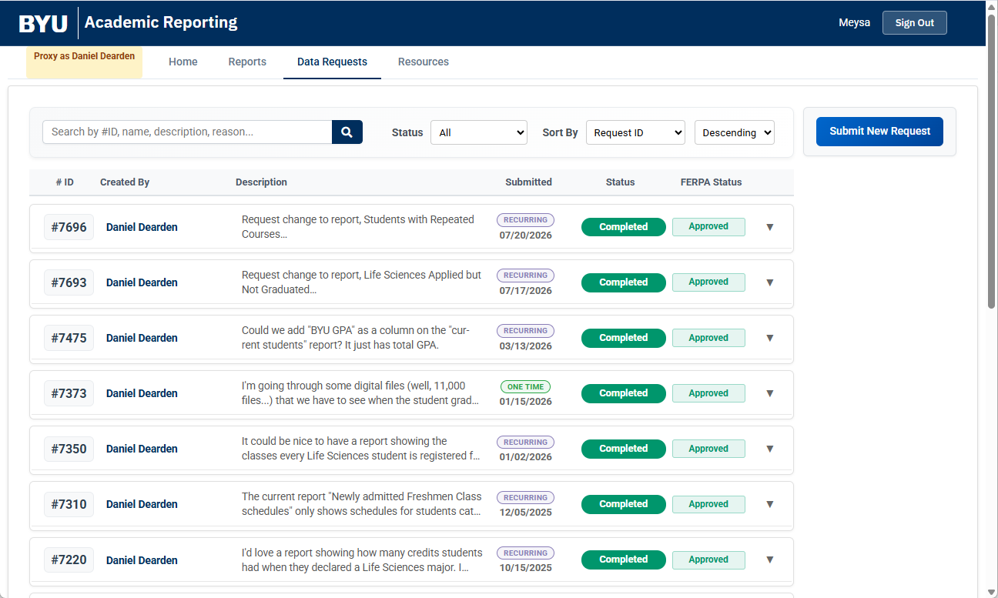
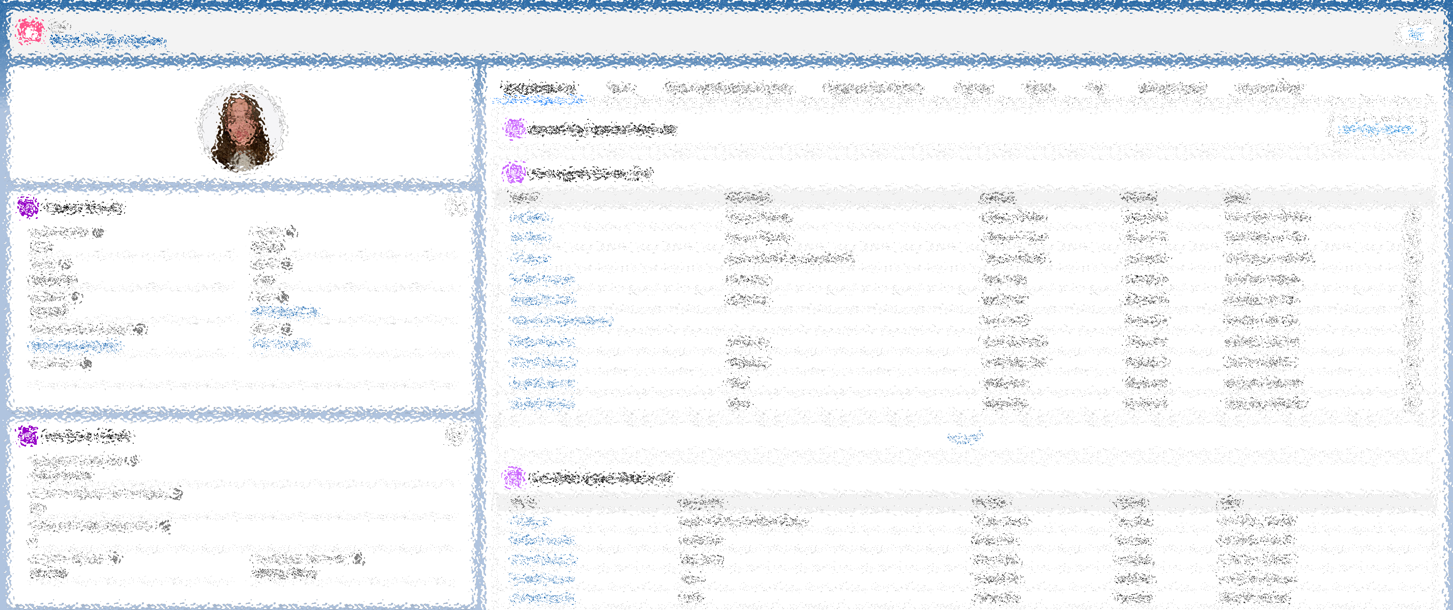
academicreporting.byu.edu

Slide 19
Submitting a Request
Before submitting a request, please review all reports you have access to first.
This will help us avoid duplication of efforts and maintaining consistency and accuracy.

Slide 20
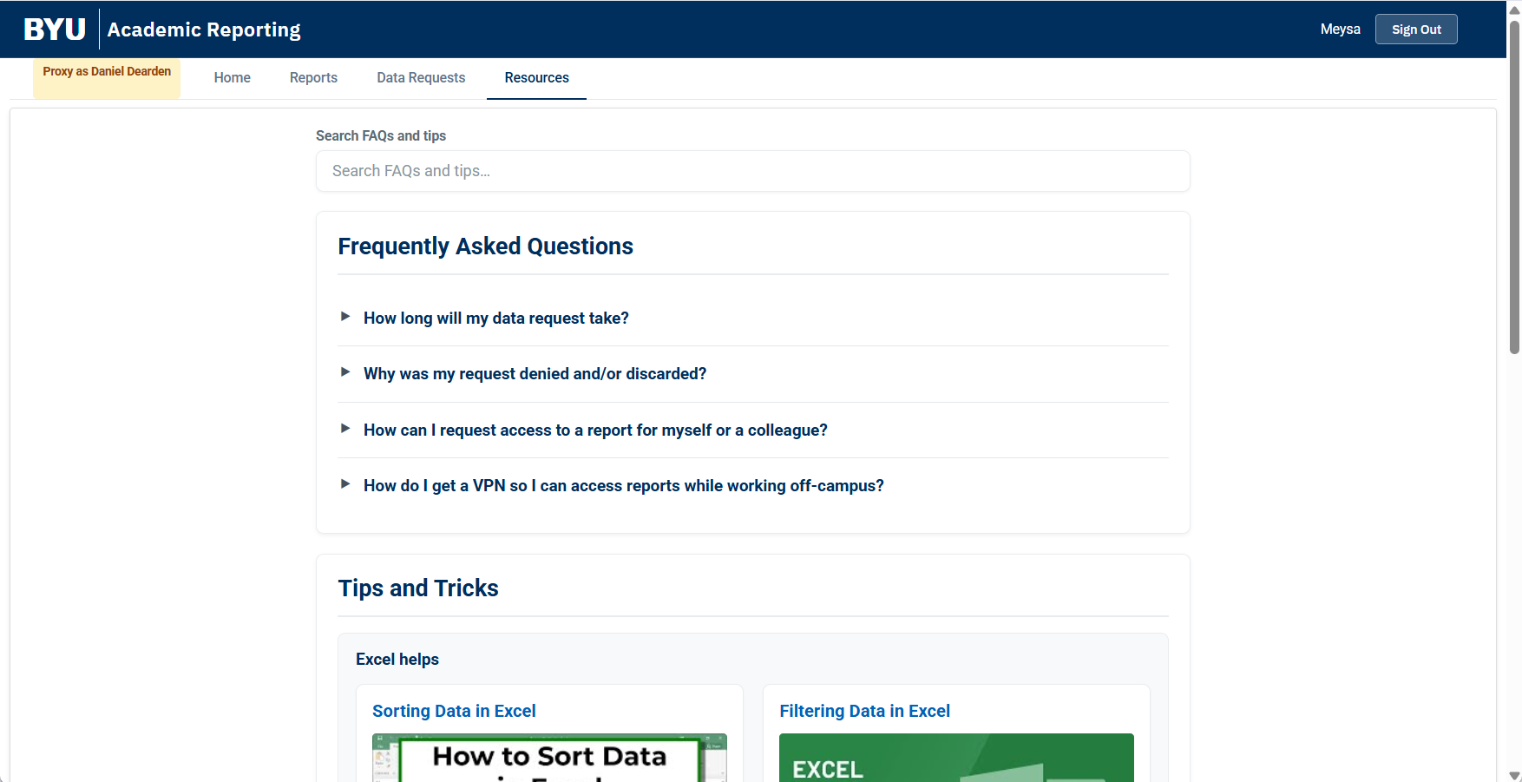
academicreporting.byu.edu

Slide 21
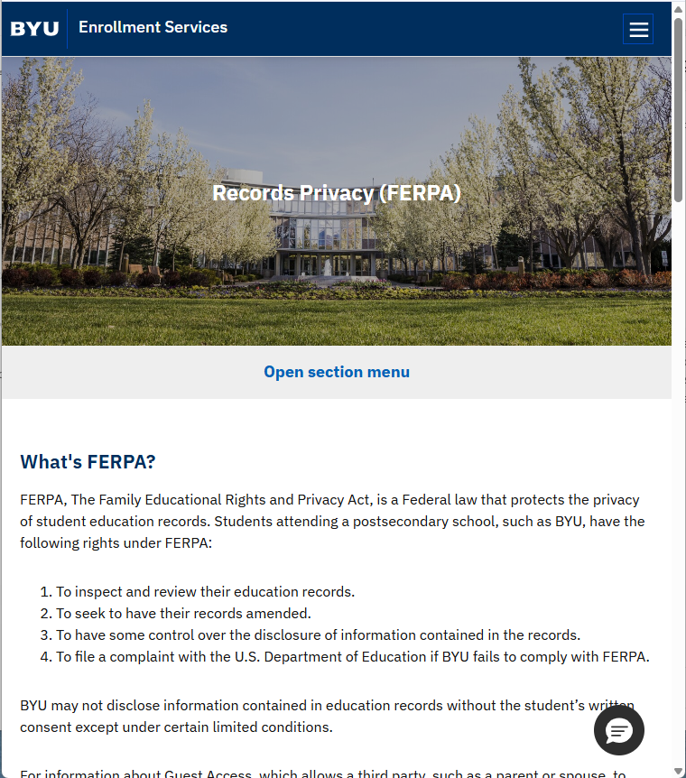
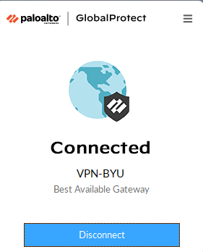
Data Viewing Requirements
FERPA training
  Must be updated within four years to request or view data
2. Access to reports
  AIM roles – aimaccess@byu.edu
  Misc. access – reports@byu.edu
3. VPN connection
  Recurring reports will require a VPN to be turned on when accessing off-campus
  Instructions can be found in the FAQs section of the reporting portal
ferpa.byu.edu

Slide 22

Other Enrollment Services Resources
Early Alert
Academic Progress Dashboard
Notes:
Our advisement community has access to these tools. If you are a faculty member or staff member that has concerns about a particular student, you can go to the advisor and work with them.

Slide 23
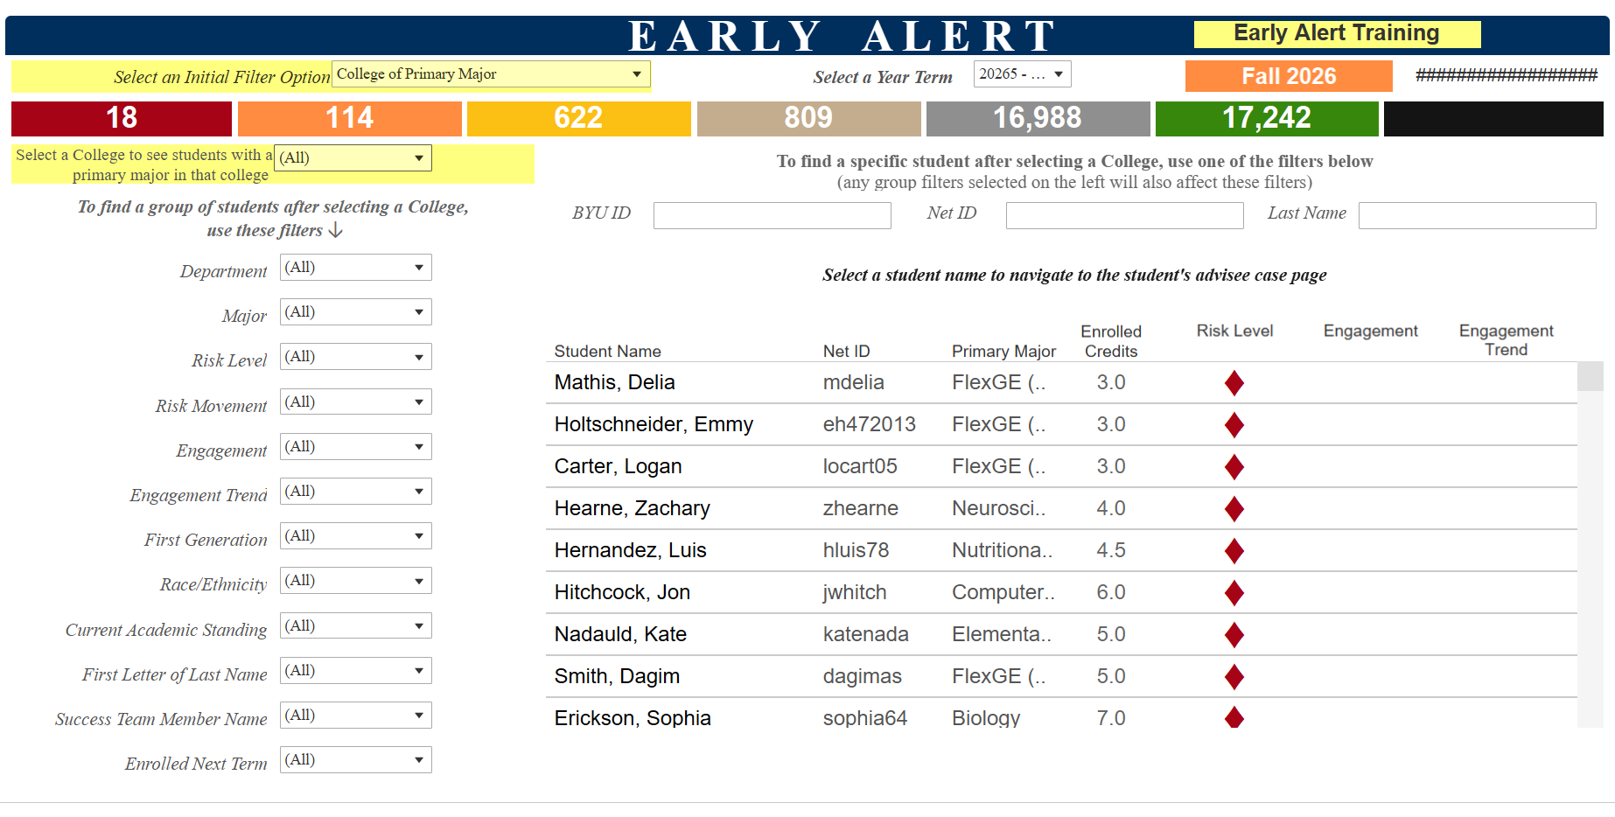
Other Enrollment Services Resources
Early Alert
Notes:
EA is a tool we have built for the advisement community. It utilizes machine learning algorithms and identifies students at risk of poor academic performance. Basically, allows us to find them before grades are final and individuals can work with them to help them get access to resources that might help them be successful. Advisors can use various filters to narrow down their list of students to those they need to reach out to.

Slide 24
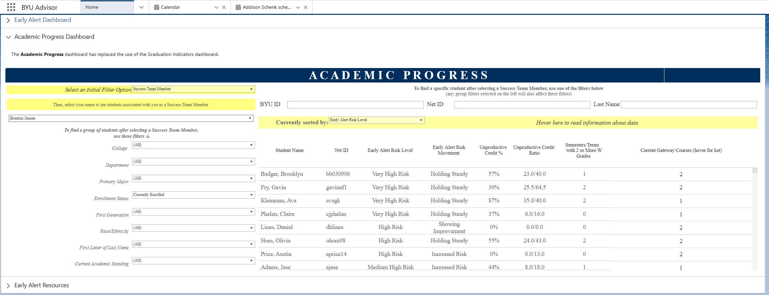
Other Enrollment Services Resources
Academic Progress Dashboard
Notes:
Academic Progress is also a tool that we built for the advisement community at the request of the Student Success Executive Council. It combines past indicators of academic performance with current indicators to give a quick view into how a student is doing. Like Early Alert, it has filters to identify students that might be in need of additional support.
Our advisement community has access to these tools. If you are a faculty member or staff member that has concerns about a particular student, you can go to the advisor and work with them.
-------------------------------------------
This is meant to give a quick glimpse into a student’s academic progress
We worked with Rosemary and Rich to select metrics that aligned with the research Rosemary’s office has done and added that to some Early Alert information.
The detail box includes 4 areas:
Unproductive credit rate – this is the number of DEWs a student has divided by the number of attempted credits
# enrollments a student has where they have multiple withdrawals (2 or more W’s) We know repeated patterns of withdrawing can be damaging for a student.
# classes a student has with a high gateway score. These courses are often critical for a student to progress towards graduation and it is important that students successfully complete these and understand their importance
EA risk level and movement (if that risk level is moving up or down) – risk of getting below a 2.0 and if that risk is trending up or down
The first two are metrics based on previous semesters (lagging metrics/backward looking): unproductive credit rate, enrollments with 2+ Ws
The last two are leading metrics (predictive metrics/forward looking): what they are currently enrolled in, current risk level
Combines previous performance with current performance into one view
In the dashboard, an advisor can come to the dashboard, select their own name, and the students in their area will populate the dashboard
These filters over here on the left and at the top will be very familiar to advisors, because they match what is in Early Alert. Can select different options to filter down their list of students.
Across the top they can look for a particular student if they need to for any reason

Slide 25

ENROLLMENT SERVICES
Contact info:
reports@byu.edu

Slide 26
ENTERPRISE DATA MANAGEMENT - OIT
Brad Bailey & Markus Carter

Slide 27
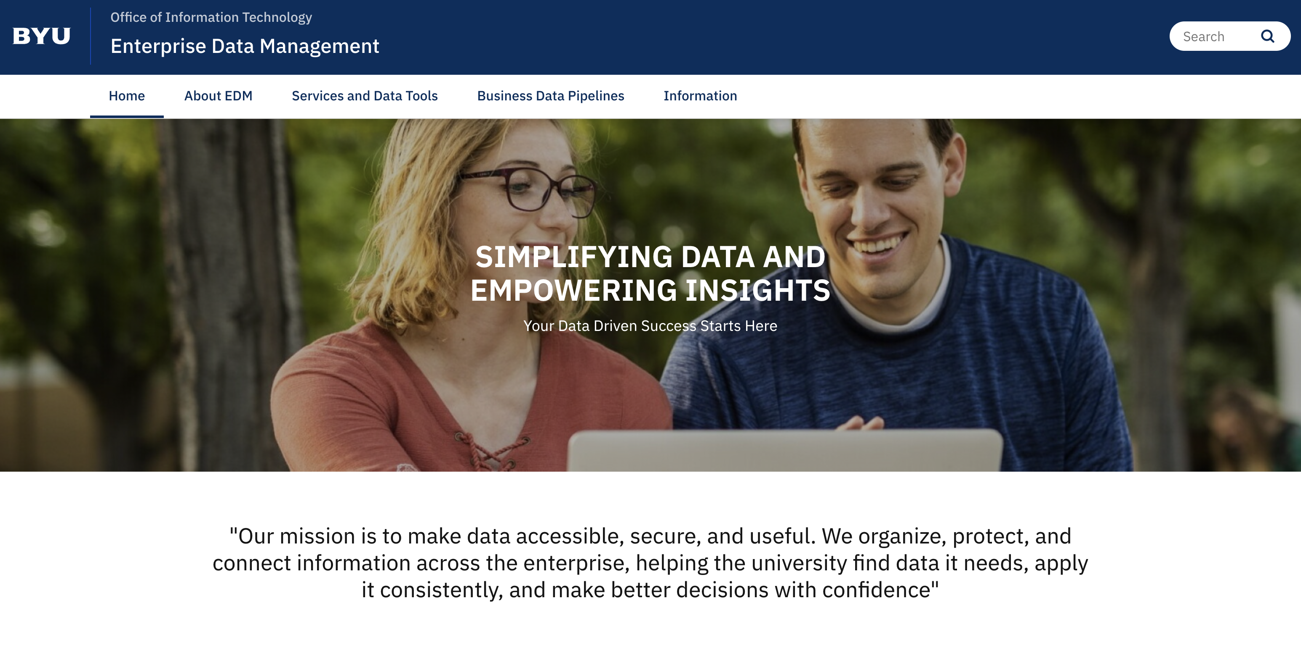
ENTERPRISE DATA MANAGEMENT (EDM)
Office of Information Technology
edm.byu.edu
Notes:
What we cover…our services (Data Visualization, Data Virtualization, Application Data Management, Database Storage & Management)
Data Governance - High-Level explanation
Alation - University Terms

Slide 28
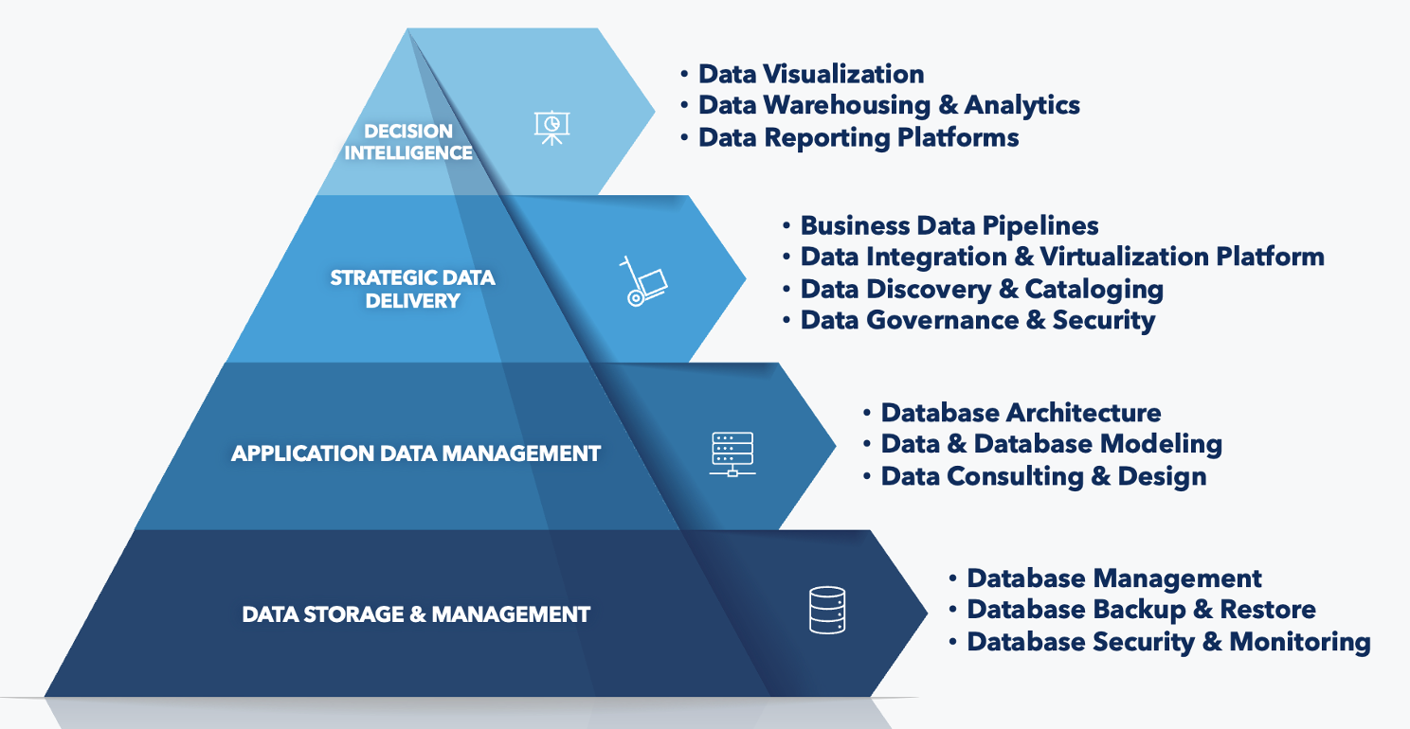
WHERE WE CAN HELP
Notes:
EDM portfolio services/data products
What we cover…our services (Data Visualization, Data Virtualization, Application Data Management, Database Storage & Management)

Slide 29
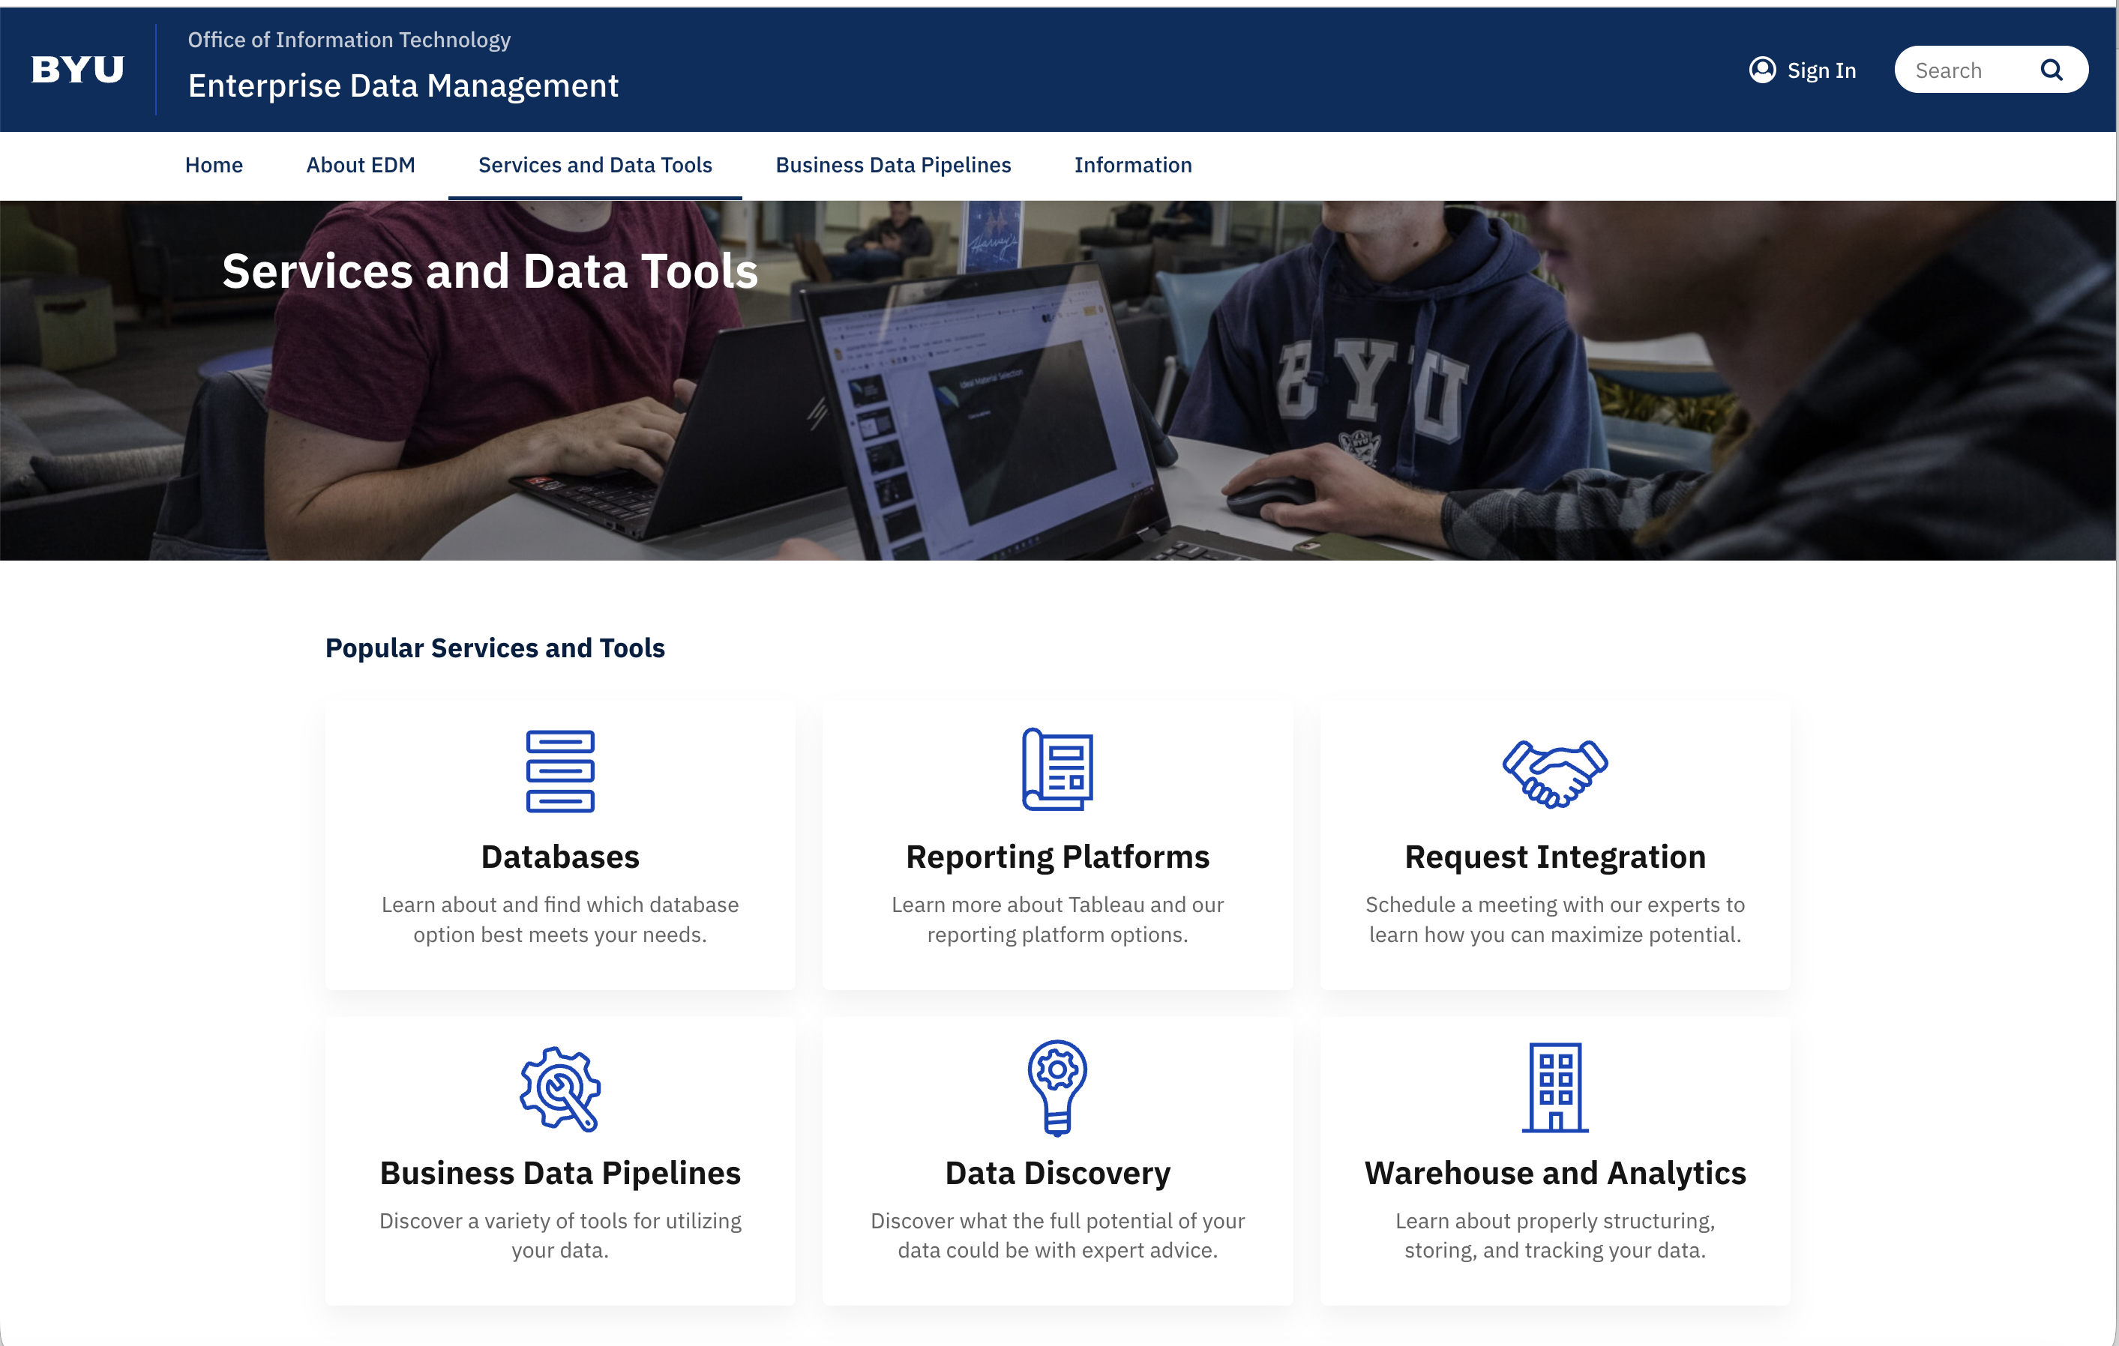
OUR SERVICES

Slide 30
ROLES AND RESPONSIBILITIES
Data Trustees
Appointing and overseeing Data Stewards
Overseeing the establishment of information protection and access policies
Promoting appropriate information use and information quality
Data Stewards
Oversee the creation of contextual business data products for the resource model in their domain
Review and approve requests for access to business data resources
Ensure information quality standards
Provide security definitions for business product access
Business Process Experts (custodians and glossary editors)
Provide business domain knowledge to create the business data products
Approving the classification of information
Notes:
The focus is on the business model and business data pipeline.
While all roles and responsibilities are important, the Data Steward is central to the Business Data Pipeline.

Slide 31
DATA CLASSIFICATION
Public
    General information that is available for public release.
Internal
    Information that is intended for those with a legitimate university purpose as allowed by statute, regulations, other legal obligations, mandates, or policy.
Confidential
    Limited access and special handling of data considered private and confidential by senior management that may not be specifically restricted by statute, regulations, other legal obligations, mandates, or policy, and must be protected against unauthorized use, access, disclosure, modification, loss, or deletion. (default classification)
Restricted
    Information that requires the strictest controls for handling and usage, and that is protected and/or regulated by statutes, regulations, other legal obligations, mandates, policy, or information deemed by Trustee as restricted.

Slide 32
HIERARCHY OF DATA
1
BDP – API/Dremio
2
Legacy API
3
Dremio
4
Table
Notes:
Describe system to system integration...BDP use cases...versus reporting use cases.

Slide 33
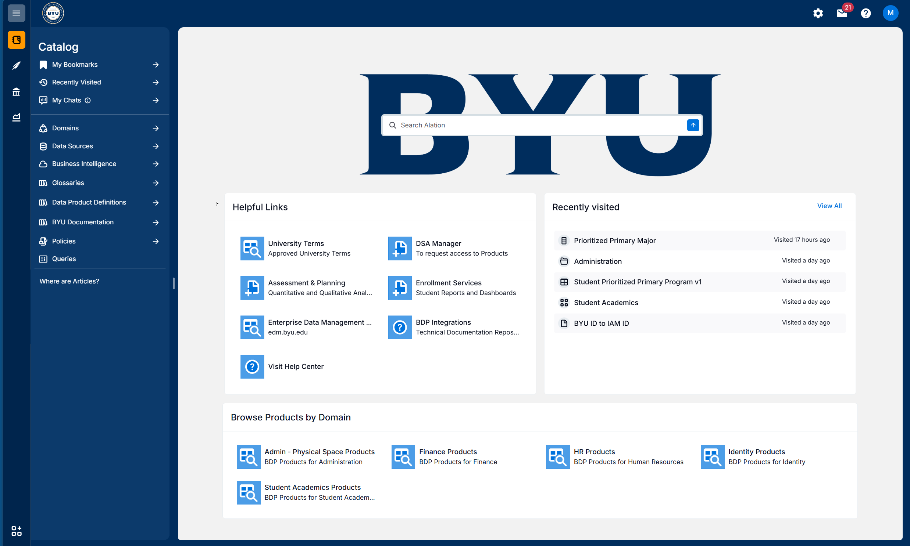
ALATION

Slide 34
TAKE AWAYS
Assessment & Planning:
  Provide quantitative and qualitative analyses (program-level to university-level).
  Visit: data.byu.edu
Enrollment Services – Research & Reporting:
  Provide the campus community with student academic data reports (Excel files and Tableau dashboards).
  Visit: academicreporting.byu.edu
Enterprise Data Management – OIT
  Provide trusted, secure, and connected data services that enable consistent access to enterprise information.
  Visit: edm.byu.edu
Notes:
Summary Slide
Assessment & Planning:
Provide quantitative and qualitative analyses (program-level to university-level)
Enrollment Services – Research & Reporting:
Provide the campus community with student academic data reports (Excel files and Tableau dashboards)
Enterprise Data Management – OIT
Provide trusted, secure, and connected data services that enable consistent access to enterprise information.

Slide 35

QUESTIONS
AND ANSWERS
CONTACT INFO
Assessment & Planning
  Zachary Barrus (zack_barrus@byu.edu)
Enrollment Services – Research & Reporting
  reports@byu.edu
Enterprise Data Management - OIT
  Brad Bailey (brad.bailey@byu.edu)

Slide 36



DATA, REPORTING & ANALYTICS
FEEDBACK SURVEY
https://forms.cloud.microsoft/r/QjqtyyVfWw

